Slide 1
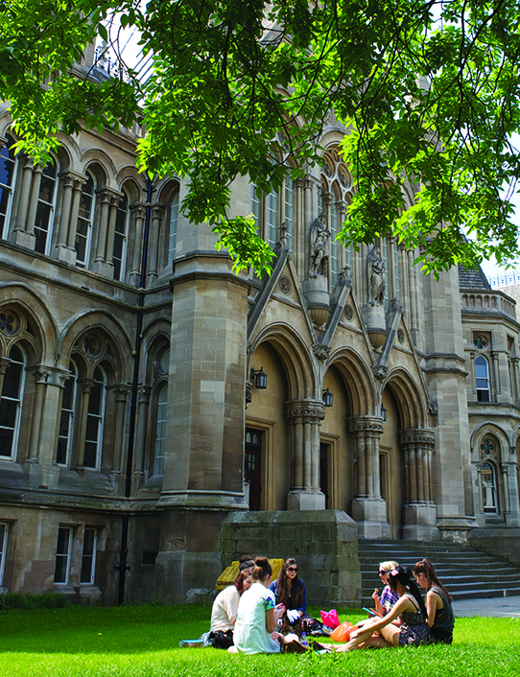
Resilience: What can we learn from the pandemic response for other crises?
Professor Nigel Wright
Nottingham Trent University
Notes:
Student numbers are headcount. Source: COGNOS June 2016
Overall 29,900 total students
4,501 PGT students
747 research students
Headcount of academic staff = 1950
Headcount of professional services staff = 2200
Total headcount = 4150

Slide 2
Resilience
...the capacity of the whole-system to…reorganize while undergoing change in flood wave frequency and severity in the long term, so as to enable it to function normally.
Gersonius, Delft FRG, 2008.

Slide 3
From Defence to Resilience?
We cannot prevent flooding completely.
We can reduce the likelihood.
We can reduce the impact.

Slide 4
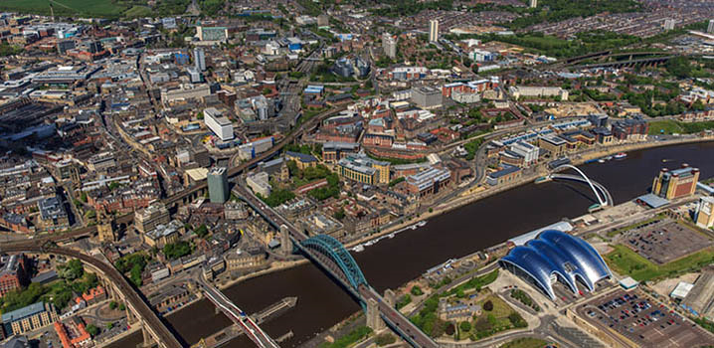
“what is required is a fundamental change in how we view flood management, from flood defence where we protect ourselves to one of resilience, living with and making space for water and the opportunity to get “more from less” by seeing all forms of water as providing multiple benefits.”
Commission of Inquiry into flood resilience of the future titled ‘Living with water’, March 2015. All Party Group for Excellence in the Built Environment, House of Commons, London SW1A 0AA: p. 32.

Slide 5
From Defence to Resilience?
We cannot prevent flooding infection completely.
We can reduce the likelihood.
We can reduce the impact.

Slide 6
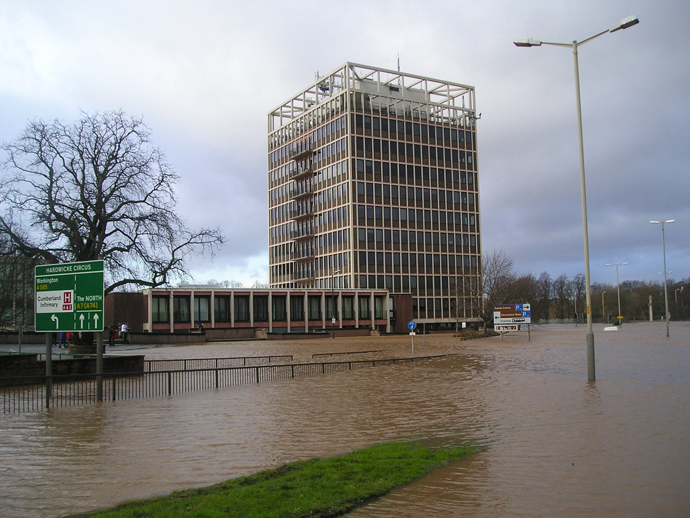
Notes:
PM has CV-19.

Slide 7
“The New Normal”
We will not return to the status quo we had before COVID-19.
We must adapt in response to each flood event.

Slide 8
Emergency Response
Autonomy vs Central Control.
Have to understand people’s behaviour and attitudes.

Slide 9
Public Understanding of Risk
Attitudes to flood and COVID-19 risk vary across individuals.
Professor Sir David Spiegelhalter (Cambridge) estimates that the risk to children of catching and then dying from coronavirus in school is comparable to travelling to school in a car.

Slide 10
Hindsight is a wonderful thing
Countries impacted by SARS and MERS were better prepared.
Dutch Flood Manager’s Prayer:
“God, gives us today our daily bread and a small flood from time to time”.

Slide 11
“When I go home, the first thing I do if it’s been raining or is raining, is stop and check the level of the drain. The last thing I do before I leave is check the level of the drain just to make sure that I’m aware of its current state.
There is a lot of anxiety if the weather is going to be bad. As we move more into winter… the anxiety, I think, will rise and it’s affecting people.“

Slide 12
Lessons to be learnt?
Resilience approach.
Understanding people’s behaviour.
Public understanding of risk.

Slide 13
Lane, 2014. Socio-hydrological systems.
Latour, 1999:
“…it might be about time for social and natural scientists to forget what separates them and start looking jointly at those “things” whose hybrid nature has, for many decades now, already unified in practice…”

Slide 14
Thank you!
Back to Cheng.

